Slide 1
Webremek-BeosztasApp
Judit Ferenczik, Debrecen, 18.05.2022

Slide 2
Motivation
Joint work with Tisza-Kis Eleonórával and Szmolka Lászlóval
László’s previous experience with similar applications and his idea
Decisions, distribute the roles and TODOs
Determine the main objective of the application
Describe the differences, similarities of the three different platforms

Slide 3
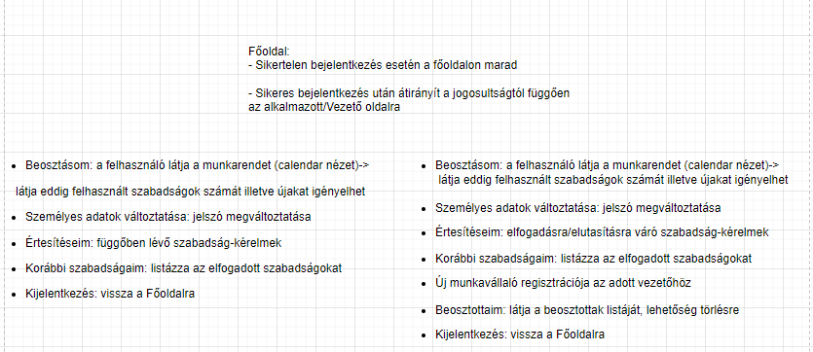
The structure of the application

Slide 4
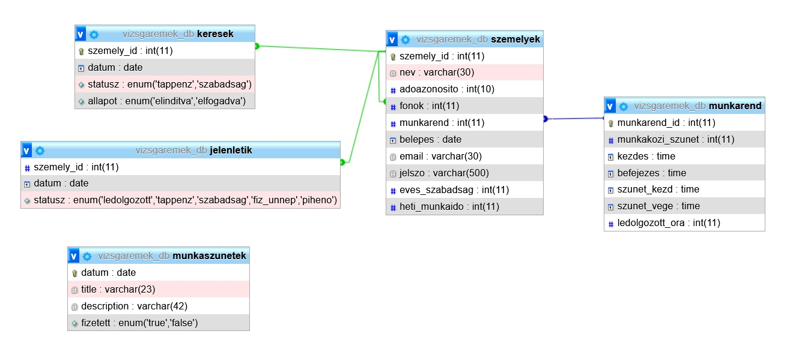
ER Diagram - Database

Slide 5
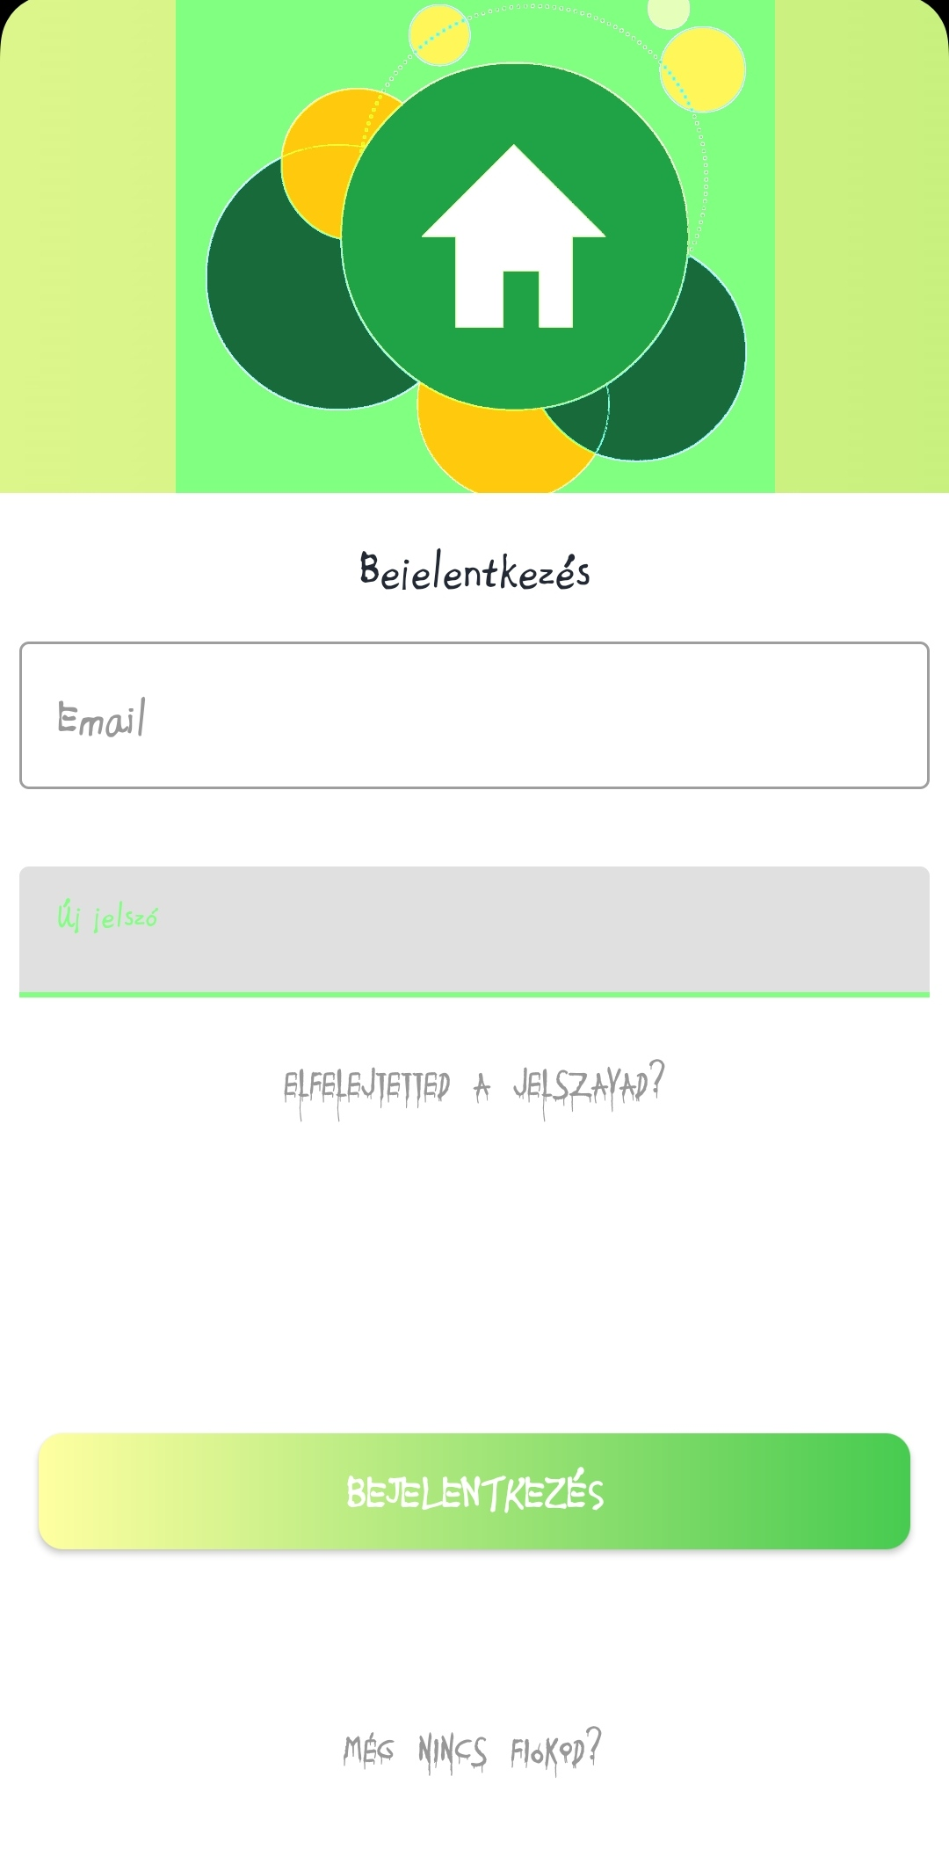

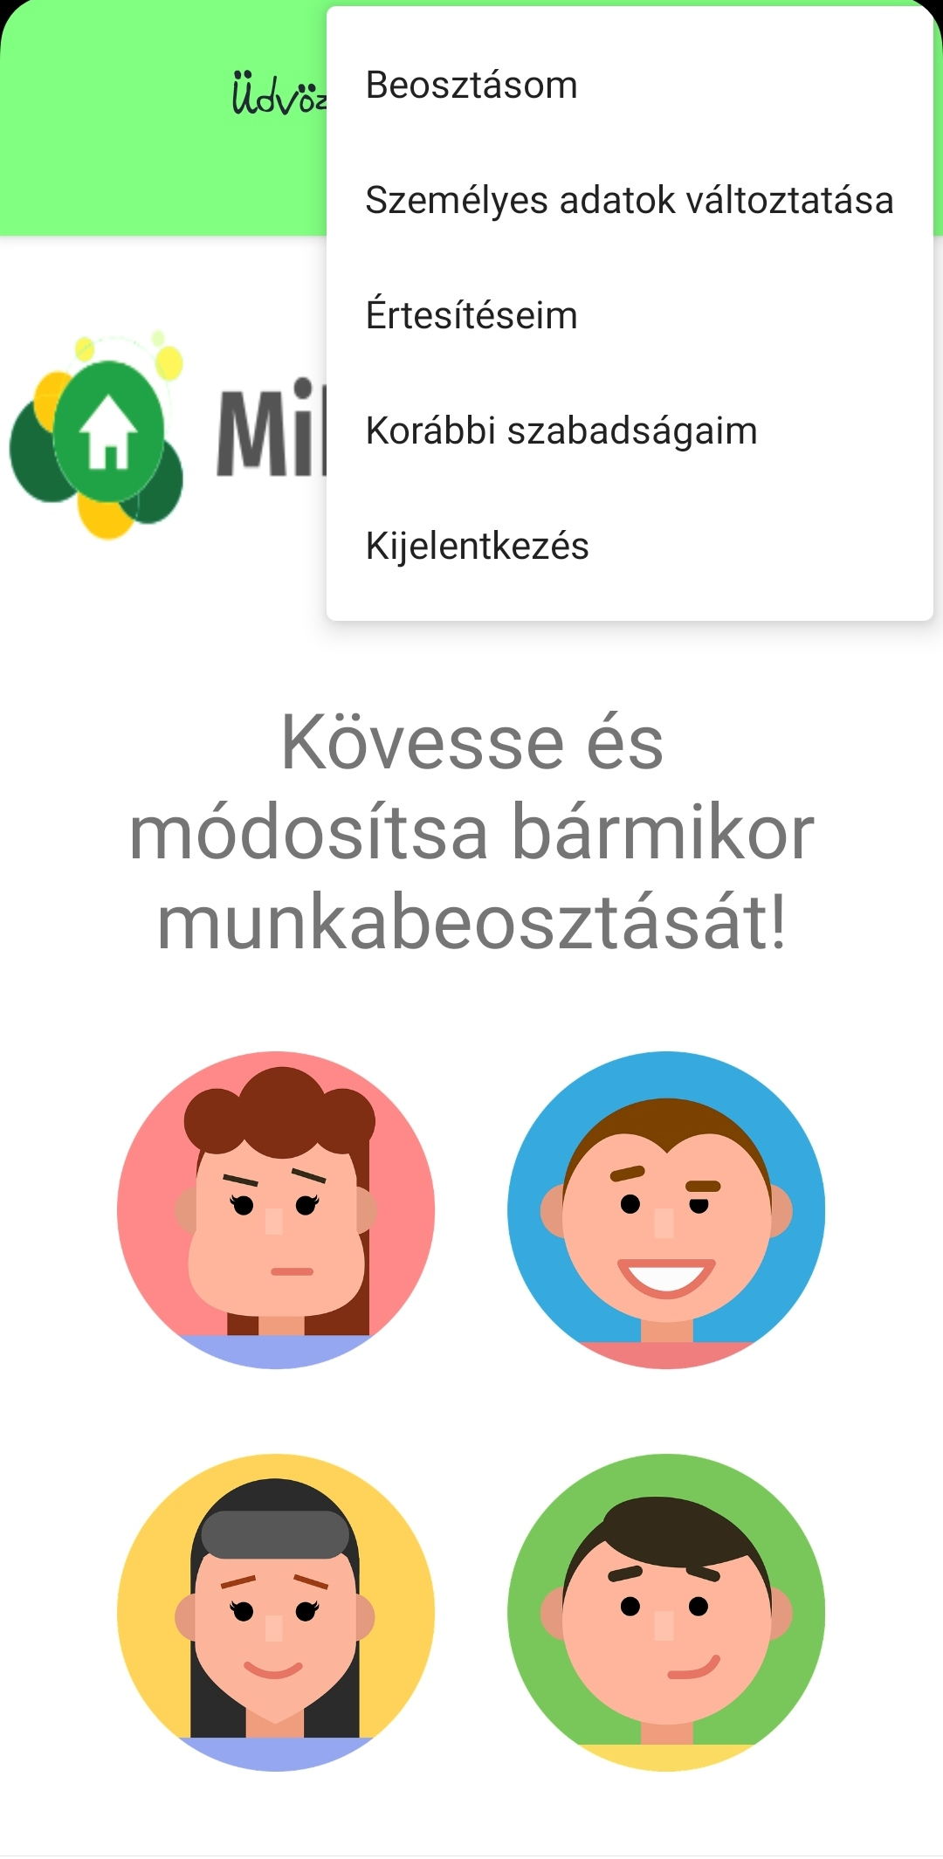
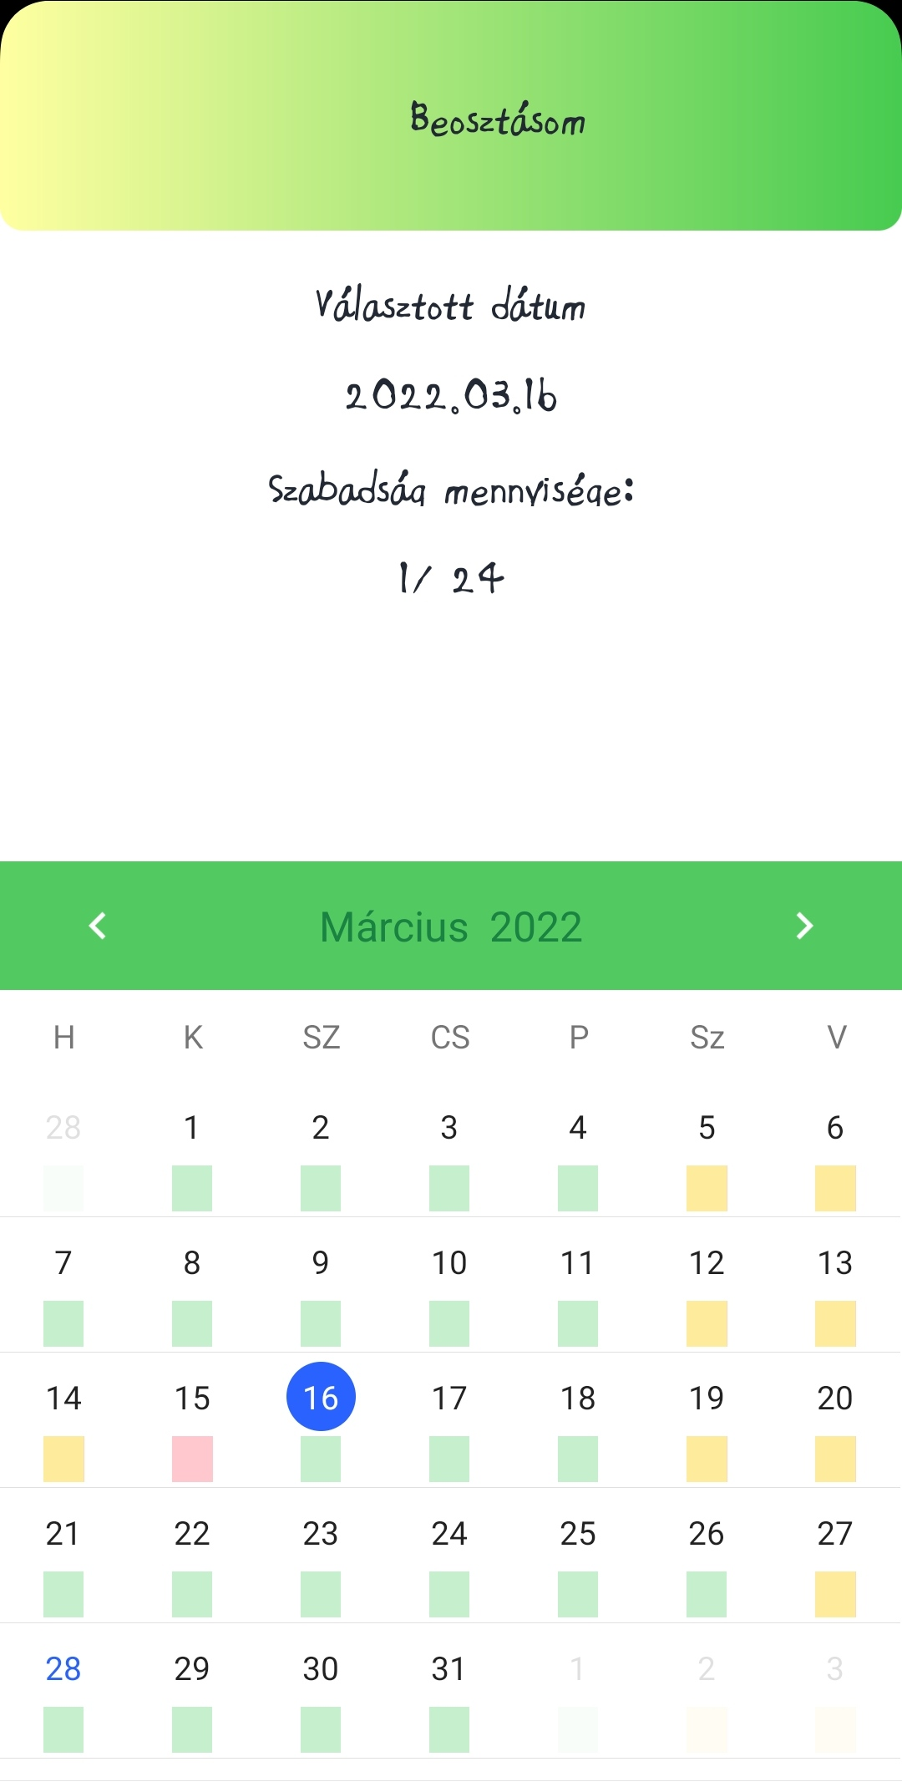
Design solutions – Employee GUI - 1.-

Slide 6
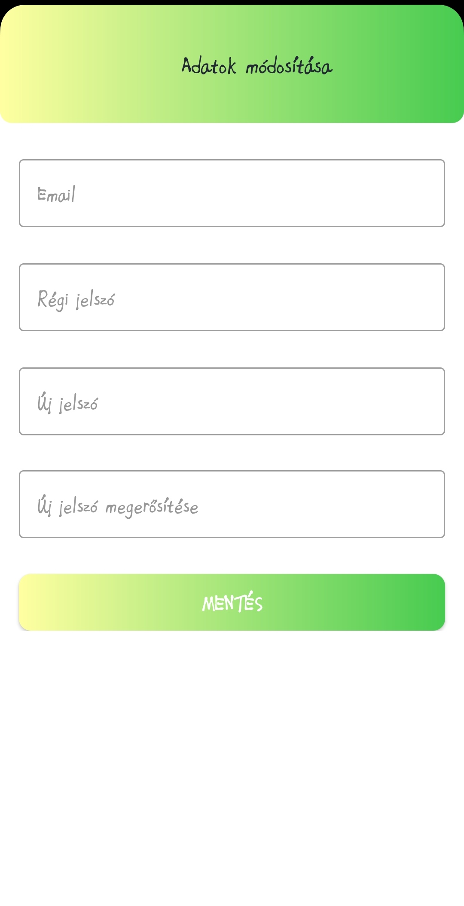
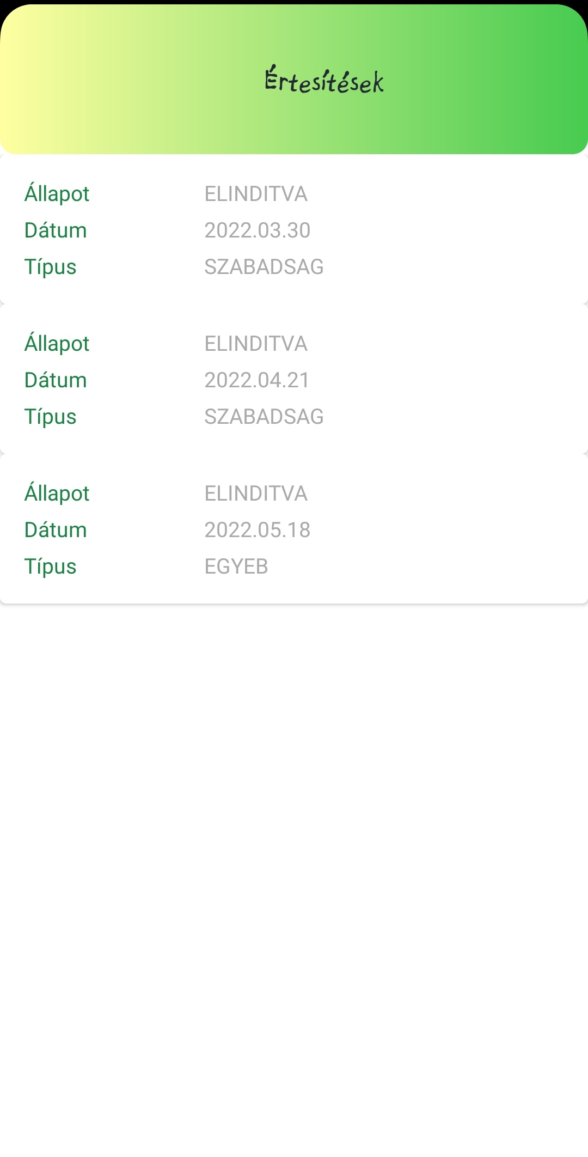
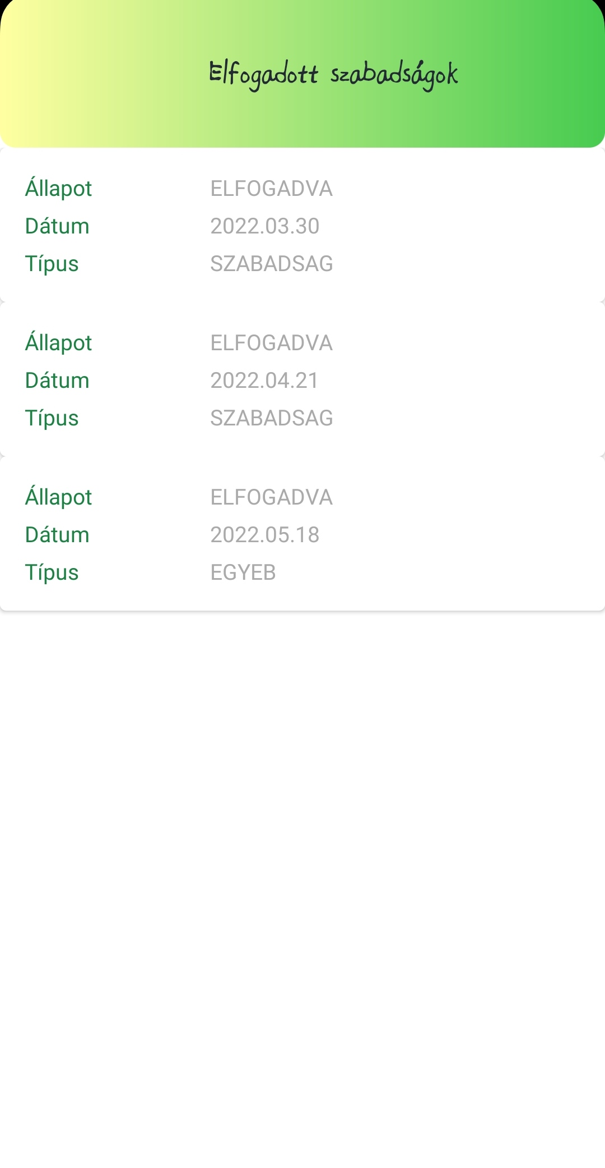
Design solutions – Employee GUI - 2.-

Slide 7


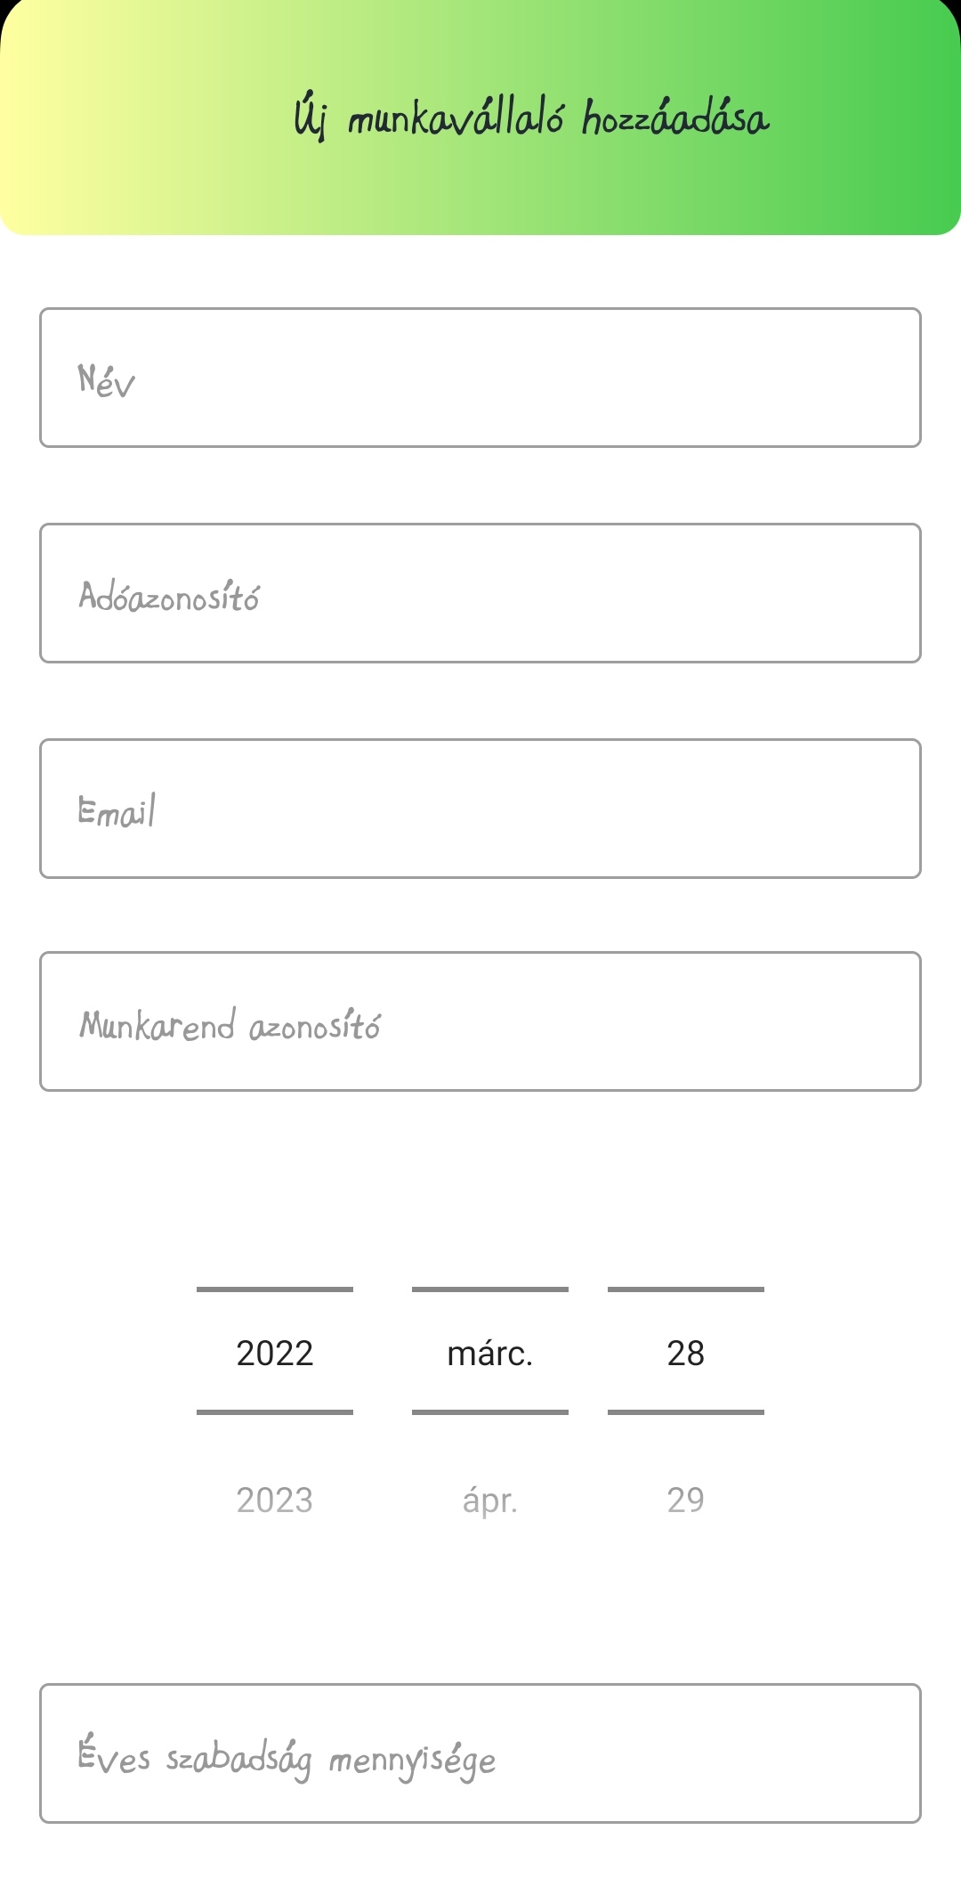
Design solutions – Employer GUI– 1. -

Slide 8
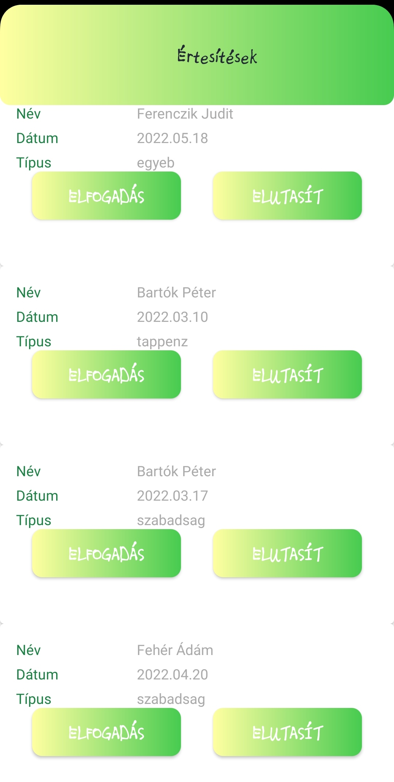
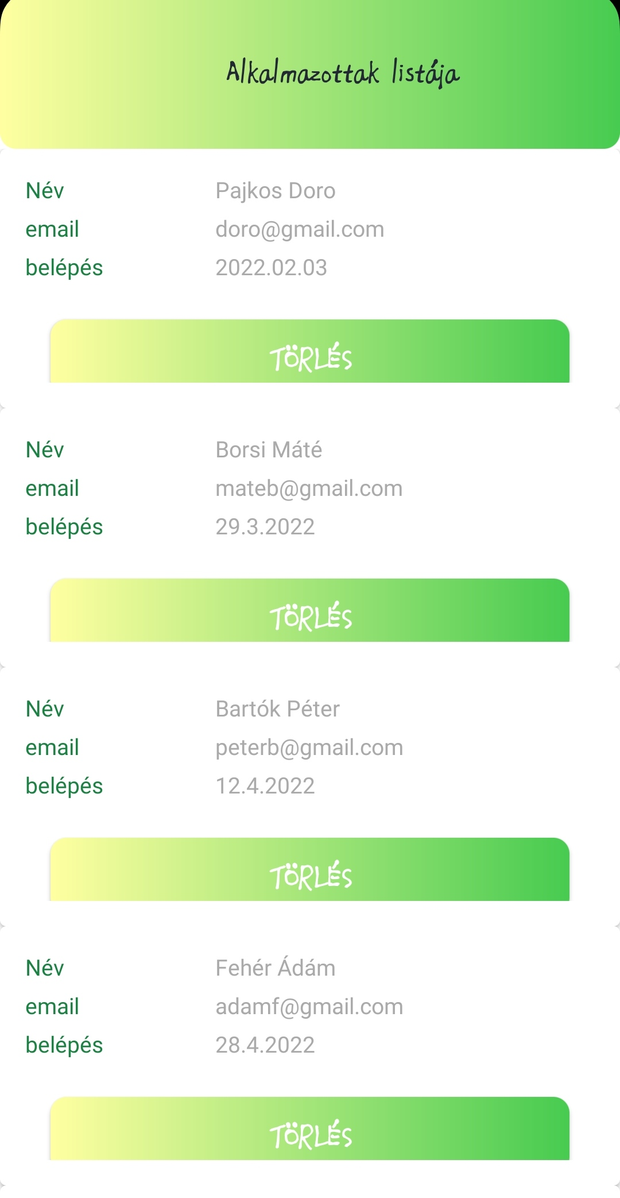
Design solutions – Employer GUI– 2. -

Slide 9
Description of a comlicated method of the app – Creation of a dynamic cardview
Methods of RecyclerAdapter (how the „accepting the request” method works):
private var onClickElfogadItem: ((ErtesitesF) -> Unit)? = null
fun setOnClickElfogadItem(callback: (ErtesitesF) -> Unit) {
this.onClickElfogadItem = callback }
override fun onCreateViewHolder(viewGroup: ViewGroup,viewType: Int): ErtesitesFRecycleAdapter.ViewHolder {
val view = LayoutInflater.from(viewGroup.context)
.inflate(R.layout.item_contact, viewGroup, false)
return ViewHolder(view) }

Slide 10
Description of a comlicated method of the app – Creation of a dynamic cardview
override fun onBindViewHolder(viewHolder: ErtesitesFRecycleAdapter.ViewHolder, position: Int) {
val tmpErtesites: ErtesitesF = dataSet[position]
val textView = viewHolder.nameTextView
textView.setText(tmpErtesites.nev)
val textView1 = viewHolder.dateTextView
textView1.setText(tmpErtesites.mikor)
val textView2 = viewHolder.tipusTextView
textView2.setText(tmpErtesites.tipus)
viewHolder.elfogadButton.setOnClickListener { onClickElfogadItem?.invoke(tmpErtesites) }
viewHolder.elutasitButton.setOnClickListener { onClickElutasitItem?.invoke(tmpErtesites) }
}

Slide 11
Description of a comlicated method of the app – Creation of a dynamic cardview
fun ertesitesekF(fonokID: Int): ArrayList<ErtesitesF> {
val resultList = ArrayList<ErtesitesF>()
val db = this.readableDatabase
val query =
"SELECT azon ,datum, statusz,szemelyek.szemely_id,nev FROM szemelyek INNER JOIN keresek ON szemelyek.szemely_id = keresek.szemely_id WHERE allapot='elinditva' AND fonok = " + fonokID.toString() + ";"
db.use {
val cursor = db.rawQuery(query, null)
while (cursor.moveToNext()) {
val ertesites = ErtesitesF(
keresek_id = cursor.getInt(0), mikor = cursor.getString(1),
tipus = cursor.getString(2), szemely_id = cursor.getInt(3),
nev = cursor.getString(4) )
resultList.add(ertesites) }
return resultList }

Slide 12
Description of a comlicated method of the app – Creation of a dynamic cardview
recyclerView =
findViewById<View>(R.id.recyclerViewErtesitesF) as RecyclerView
initRecycler()
getErtesitesek()
adapter?.setOnClickElfogadItem {
elfogadErtesites(it.keresek_id)
getErtesitesek()
}
adapter?.setOnClickElutasitItem {
elutasitErtesites(it.keresek_id)
getErtesitesek()
}

Slide 13
Description of a comlicated method of the app – Creation of a dynamic cardview
private fun initRecycler() {
recyclerView.layoutManager = LinearLayoutManager(this)
adapter = ErtesitesFRecycleAdapter()
recyclerView.adapter = adapter
}
private fun getErtesitesek() {
val ertesitesekF = sqliteHelper.ertesitesekF(ered)
if (ertesitesekF.size == 0) {
Toast.makeText(this, "Nincs megjelenítendő értesítés!", Toast.LENGTH_LONG).show()
}
adapter?.addItems(ertesitesekF)
}

Slide 14
Description of a comlicated method of the app – Creation of a dynamic cardview
private fun elfogadErtesites(id: Int) {
val builder = AlertDialog.Builder(this)
builder.setMessage("Biztos elfogadja a szabadságot?")
builder.setCancelable(true)
builder.setPositiveButton("Igen") { dialog, _ ->
sqliteHelper.elfogadSzabi(id)
Toast.makeText(this, "Kérelem elfogadva!", Toast.LENGTH_LONG).show()
dialog.dismiss()
val intent = Intent(this, ErtesitesFActivity::class.java)
intent.putExtra("szemelyid", ered)
intent.putExtra("nev", nev)
startActivity(intent) }
builder.setNegativeButton("Nem") { dialog, _ ->
dialog.dismiss() }
val alert = builder.create()
alert.show() }

Slide 15
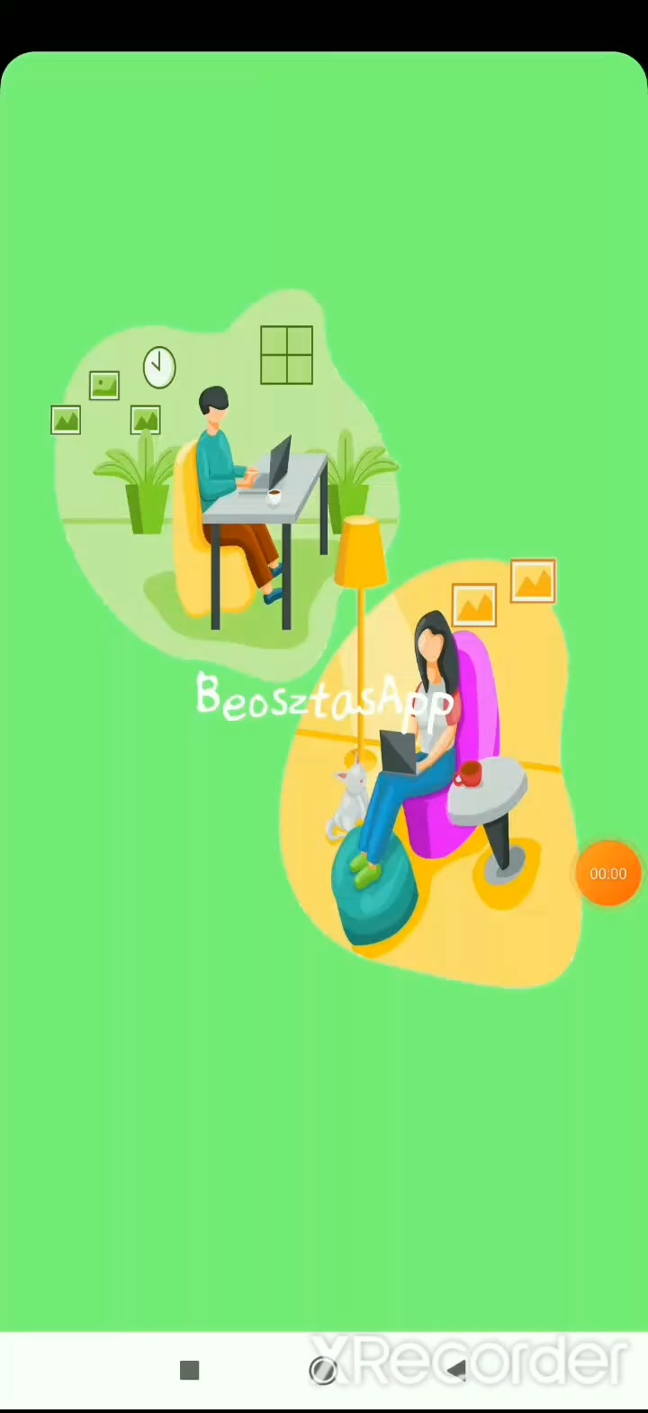
Application in action

Slide 16
Future plan – Further improvements
Fix work hours vs. Flexible work hours
Extension of the number of „work-day” types
Extension of the number of holiday types
Start the salary calculation from the appication itself
Add documentation of the meaning of the colors to the calendar page

Slide 17
Thank you for your attention!

